Slide 1
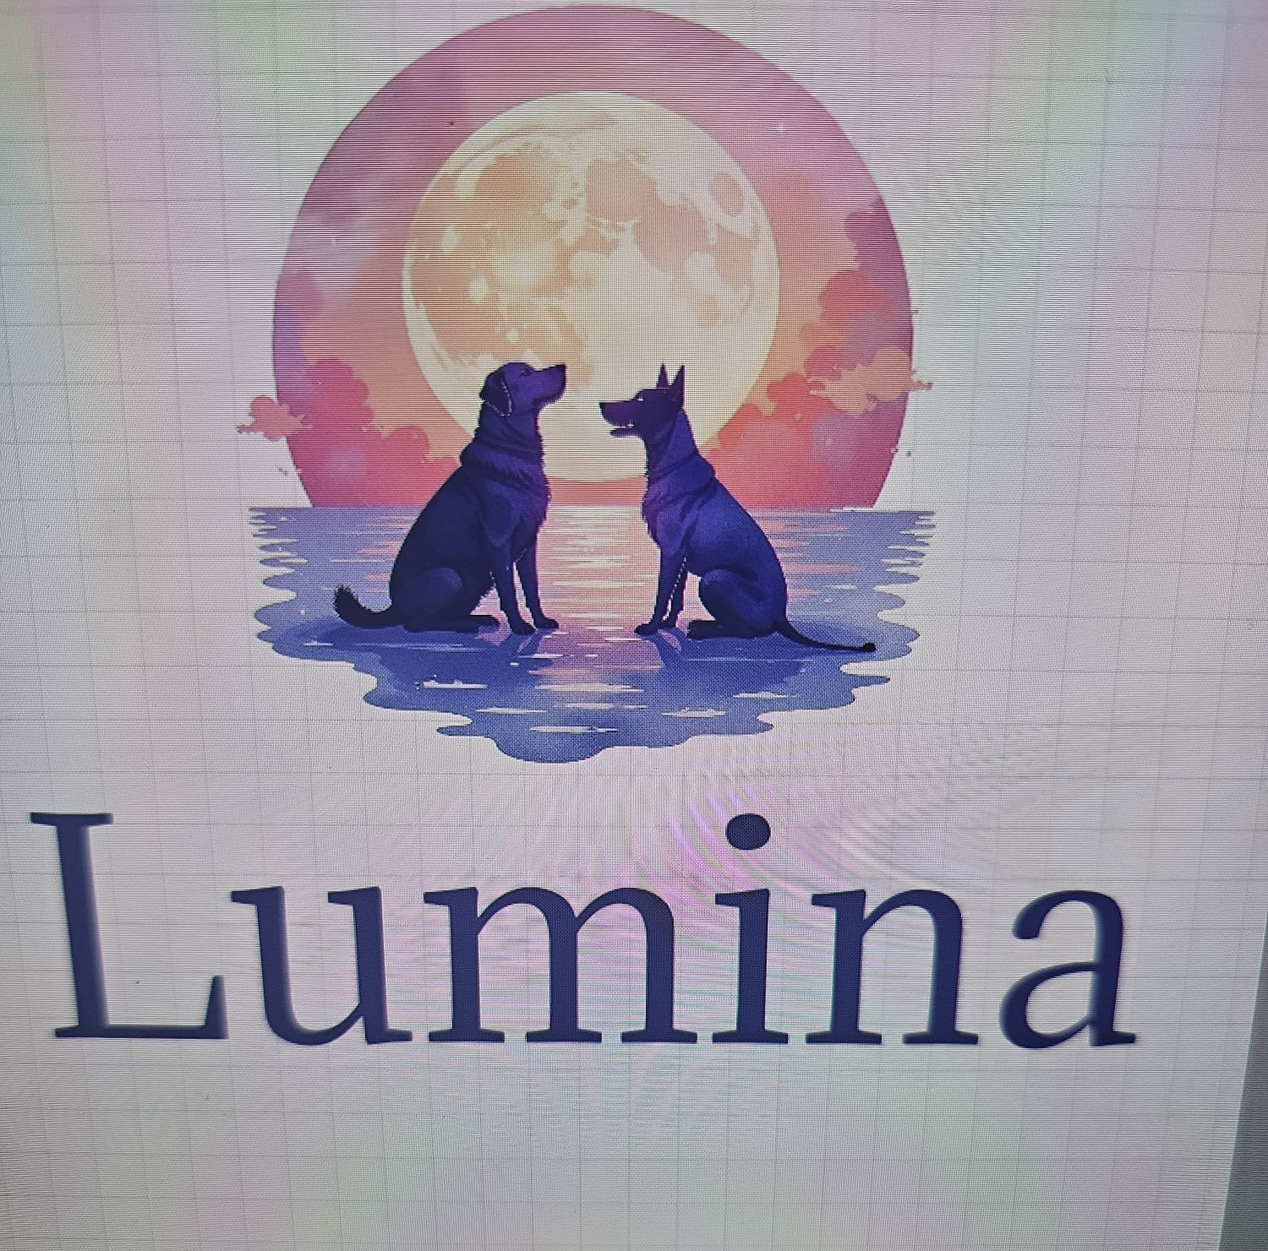
LUMINA - Your beacon of hope and support
Team 7:
Snehanjani Pati
Sravya Vemireddy
Sireesha Gangarapu
Pravallika Challa
Pavan Ganeshreddy Yeruva

Slide 2
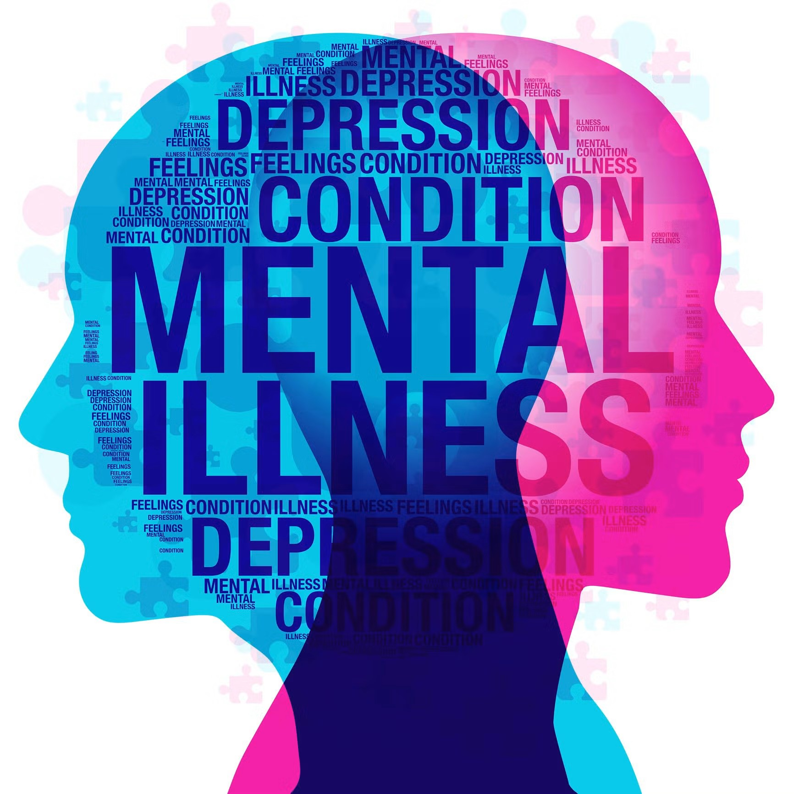
Introduction
Project Objective:
The goal of this project is to create an easy-to-use, affordable, and real-time support system for people dealing with mental health issues like stress, anxiety, and depression. It will provide instant emotional help through an AI chatbot, connect users with available professionals, and offer resources for self-care, making sure people can get the support they need whenever they need it.
Tools and Technologies:
Frontend: HTML5, CSS, JavaScript
Backend: Node.js
AI/ML: TensorFlow, Keras
Database: Firebase
Deployment: GitHub Pages, Vercel
Tools: Visual Studio Code, GitHub, Firebase, Figma
Significance:
This project provides quick, affordable mental health support, making it easier for people to access help when they need it most. It offers instant assistance, connects users to professionals, and provides self-care tools.

Slide 3

Problem Statement
Mental health challenges such as stress, anxiety, and depression are increasing worldwide, yet access to professional support remains a major barrier due to high costs, long waiting periods, and limited availability of crisis services. Many individuals in distress require immediate emotional assistance, but traditional therapy and helplines are often inaccessible when needed. There is a growing need for an affordable, scalable, and real-time support system that can provide timely intervention, emotional guidance, and bridge the gap between individuals and professional mental health care.

Slide 4
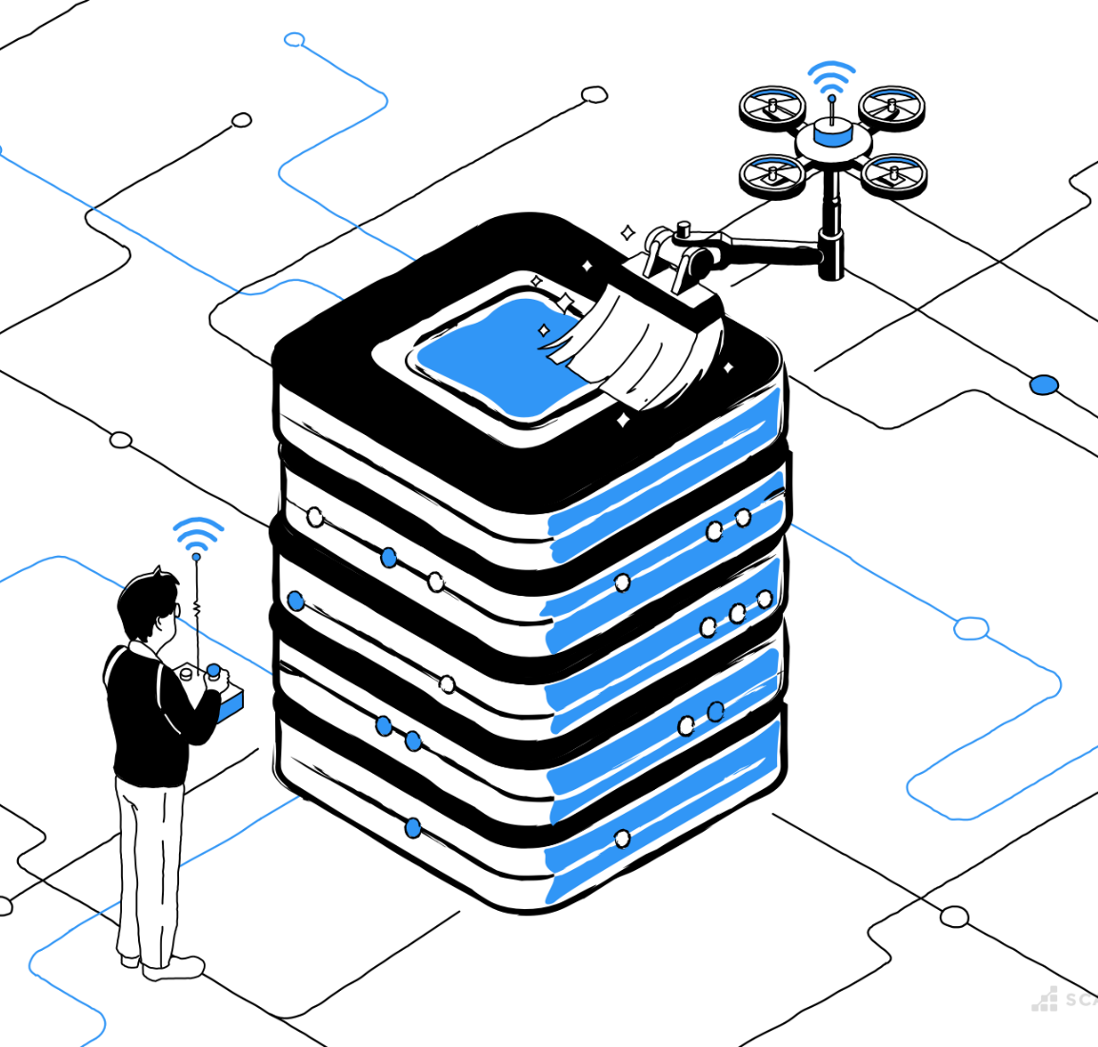
Data Preprocessing
Data Cleaning & Preprocessing
Handling Missing Values
Removal of incomplete data
Imputation (mean, median, mode, or predictive methods)
Handling Duplicates & Inconsistencies
Identifying and removing duplicate records
Standardizing inconsistent data formats
Data Type Conversions
Converting categorical data into numerical (one-hot encoding, label encoding)
Adjusting incorrect data types (e.g., dates, floats, integers)
Feature Engineering & Transformations
Creating new features from existing data
Normalization & scaling for numerical data
Encoding categorical variables
This ensures a clean, structured, and analyzable dataset for further processing.
Here’s a concise slide-friendly version for your PowerPoint on Data Cleaning & Preprocessing:

Slide 5
Dataset Overview - LUMINA Survey Responses
Identity Preference – Whether the respondent chose to remain anonymous or share their identity.
Demographics: Age group ,Gender, Occupation
Mental Health Status: Mood rating (scale of 1 to 10) ,Frequency of depression ,Self-reported well-being over the past month
Coping Mechanisms – Methods that help respondents feel better (e.g., music, talking to friends).
Comfort in Sharing Feelings – Whether respondents feel comfortable talking about their emotions.
Survey Experience: Ease of completing the questionnaire , Whether the survey helped in self-reflection ,Interest in future mental health discussions/studies , Suggestions for improving the survey
Ratings & Additional Comments – Overall rating and optional feedback.
Consent for AI and Medical Research – Respondents’ views on sharing their data for research purposes.

Slide 6

Methodology
The EDA process was conducted as follows:
1. Exploratory Analysis: Using summary statistics to pre-analyze data.
2. Visualization: Using Matplotlib and Seaborn libraries to plot the findings clearly.
3. Statistical Analysis: Analyze correlation tests and a trend analysis to develop insights into the data.

Slide 7

Histograms
Mood Today: Responses are mostly centered around 7, showing a near-normal distribution of mood levels.
Well-Being Over the Past Month: Most responses cluster around 3, indicating moderate well-being for many participants.
Questionnaire Rating: Majority rated it highly (9 or 10), suggesting positive feedback.
Overall Trend: Mood varies, well-being leans toward average, and the questionnaire was well-received.

Slide 8
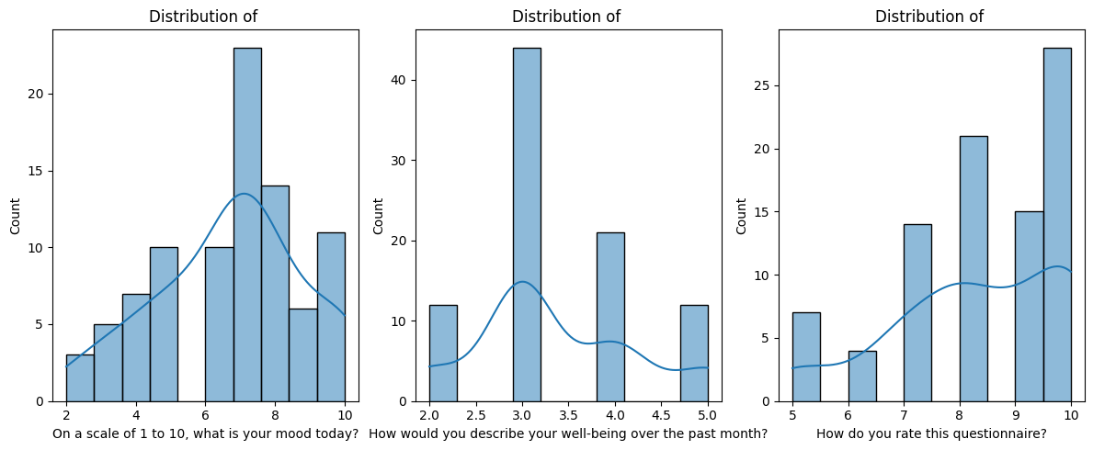
Add a Slide Title - 2

Slide 9

Box Plots for Outlier Detection
Slide Title: Boxplot Analysis
Mood Today: Responses range from 2 to 10, with a median around 7, indicating a generally positive mood.
Well-Being Over the Past Month: Responses range from 2 to 5, with a median near 3, showing a moderate level of well-being.
Questionnaire Rating: Responses range from 5 to 10, with a median around 8, suggesting overall positive feedback.
Overall Trend: Mood and questionnaire ratings are generally high, while well-being scores are more concentrated around the lower end.

Slide 10
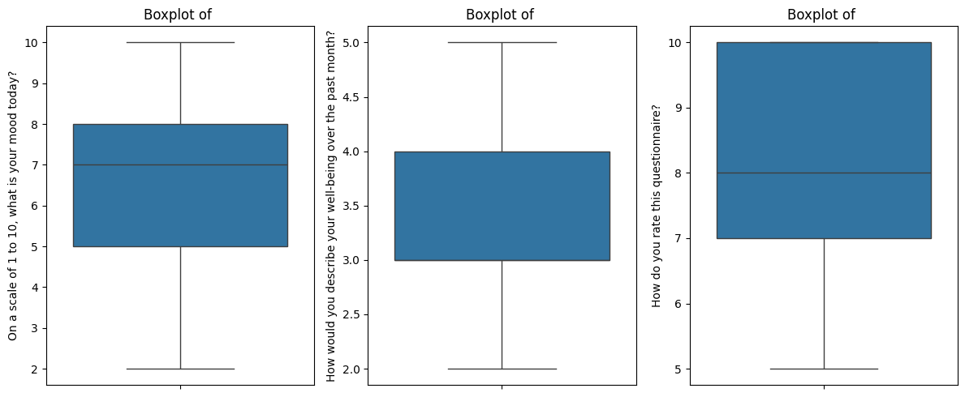
Add a Slide Title - 2

Slide 11
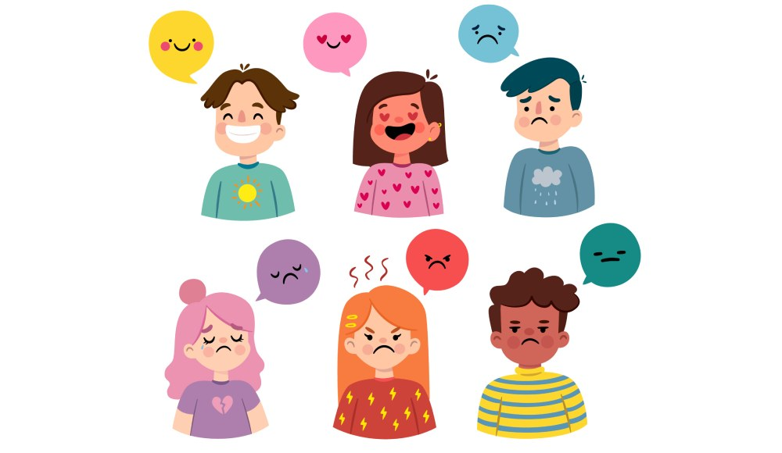
Scatter Plot - Mood vs Well-being
This scatter plot shows the relationship between Mood Score (X-axis) and Well-being Score (Y-axis). Each point represents an individual's recorded scores. The distribution helps identify patterns or trends in mood and well-being. Higher mood scores may indicate better well-being.

Slide 12
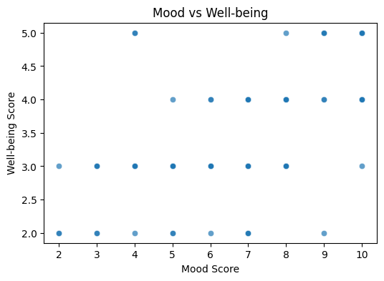
Add a Slide Title - 2

Slide 13
Heatmap
Slide Title: Correlation Heatmap Analysis
Mood & Well-Being: A moderate positive correlation (0.55) suggests that better mood today is linked to better well-being over the past month.
Mood & Questionnaire Rating: A weak correlation (0.23) indicates that mood has little impact on how participants rate the questionnaire.
Well-Being & Questionnaire Rating: Similarly, a weak correlation (0.24) suggests that past well-being does not strongly influence questionnaire ratings.
Overall Insight: Mood and well-being are somewhat related, but ratings of the questionnaire appear independent of emotional state.

Slide 14
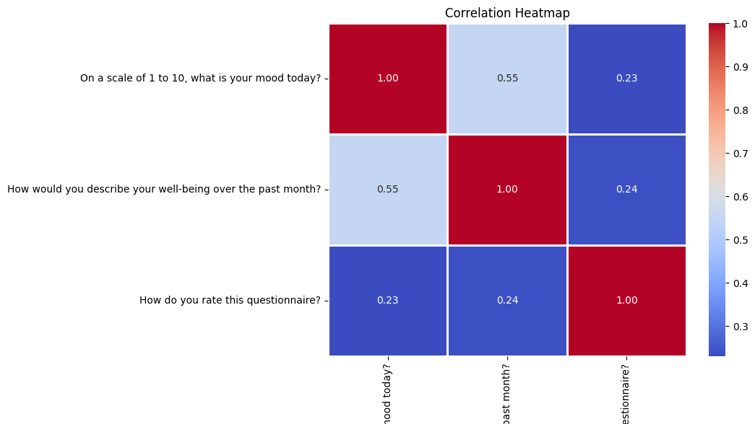
Add a Slide Title - 2

Slide 15
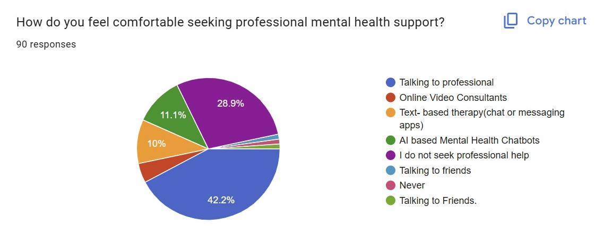
Key Insights using Graphs and Plots
The data highlights a significant preference for talking to professionals, followed by online video consultations and Ai based mental health Chartbots. This information can be valuable for mental health service providers to tailor their offerings to meet client preferences.

Slide 16
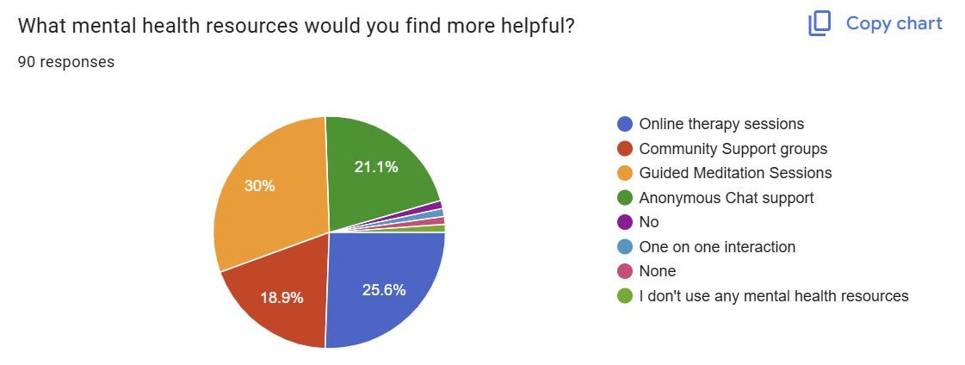
Key Insights using Graphs and Plots
The survey of 90 respondents highlights that Guided Meditation Sessions (30%) and Online Therapy Sessions (25.6%) are the most preferred mental health resources, indicating a strong interest in both self-help and professional support. Anonymous Chat Support (21.1%) and Community Support Groups (18.9%) also play a significant role, reflecting the need for private and peer-based assistance. A small portion of respondents do not use any mental health resources, emphasizing the importance of increasing awareness and accessibility to mental health support.

Slide 17
Visual Trends or Patterns in the Data
Expected Trend: People with higher mood ratings generally report better well-being scores.
Possible Anomalies: Some people may rate their mood low but their well-being high (suggesting short-term mood fluctuations).
Survey Difficulty Impact: If those who found the questionnaire hard rated it low, improving the survey structure could be a next step.

Slide 18
Any Surprising Findings That Impact Next Steps
If younger age groups dominate, future surveys should target older demographics for balance.
If there's a weak correlation between mood and well-being, external factors (like job stress) may play a role.
If mood ratings cluster in the middle (5-7 range), respondents may hesitate to choose extreme values, indicating survey design biases.

Slide 19
Challenges in Data Collection & AI Training
1️⃣ Incomplete Professional Dataset Collection
Challenge: Difficulty in acquiring a comprehensive dataset from licensed mental health professionals.
Impact: Limits the model's ability to provide clinically accurate predictions and insights.
2️⃣ Neutral Values in Dataset
Challenge: Presence of ambiguous or neutral sentiment values in mental health datasets.
Impact: Affects classification accuracy, leading to challenges in distinguishing between positive, negative, or critical mental health cases.
3️⃣ AI Training Complexity
Challenge: Requires extensive fine-tuning, high computational power, and domain-specific adjustments.
Impact: Risk of bias, overfitting, or misinterpretation of mental health data without careful model training and validation.

Slide 20
Next Steps & Implementation Plan
Designing the Lumina Logo
Develop a brand identity that reflects trust, innovation, and mental health support.
Ensure simplicity, scalability, and relevance for multiple platforms.
Integrating a Professional Dataset
Acquire and validate a dataset from licensed mental health professionals.
Ensure data diversity, accuracy, and relevance for AI-driven insights.
Implementing a Professional Chatbot
Enhance chatbot with NLP & AI for empathetic and context-aware responses.
Integrate clinical knowledge to improve interaction quality.
Merging Frontend & Backend Development
Ensure seamless real-time communication between the user interface & backend services.
Optimize for scalability, security, and performance.
Creating a Professional & User Dashboard
Design an interactive user dashboard for mental health tracking & insights.
Develop a professional dashboard with analytics, reports, and AI-driven recommendations.

Slide 21
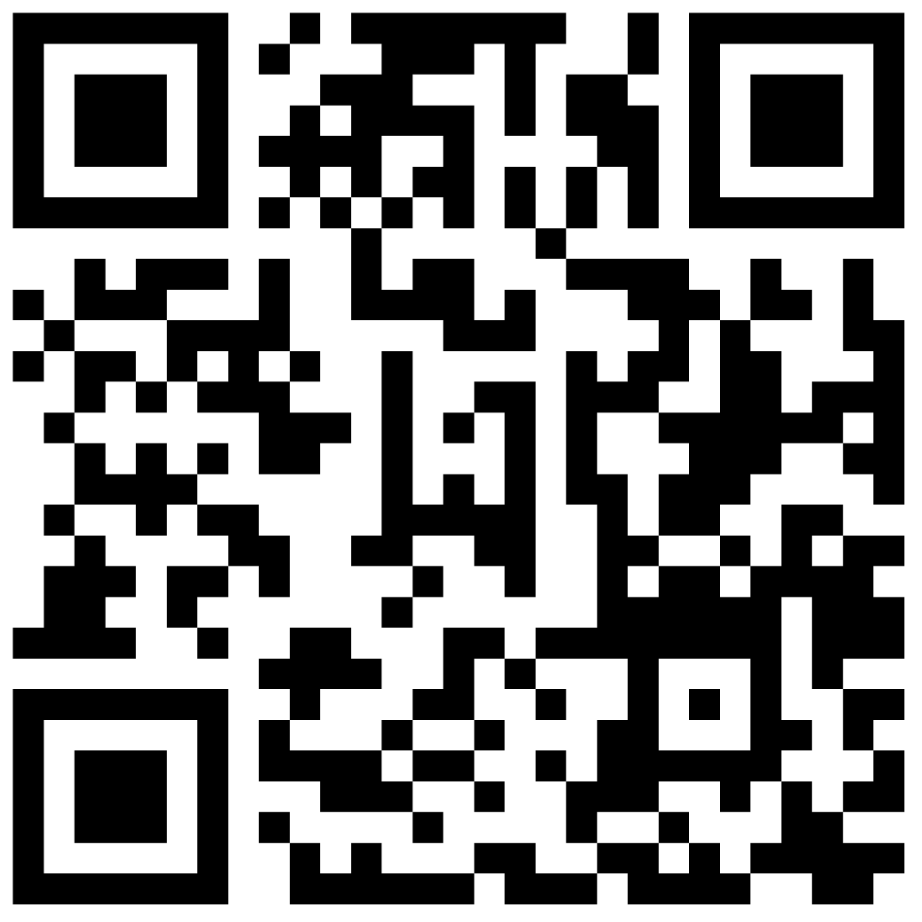
Lumina Survey

Slide 22


Slide 23


